Slide 1
Basketball Fans

Slide 2
Our FAQ
1.- The effect of the age factor in the performance varies depending on the position.
2.- Salary
3.- % de los juegos empezó como titular.

Slide 3
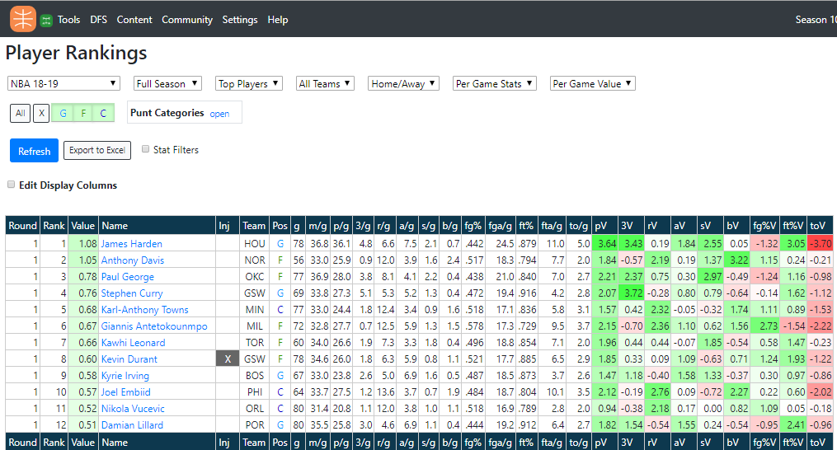

Our data

Slide 4
Exploration and Cleanup Process

Slide 5
Analysis process (jupyter notebook)

Slide 6
Conclusions (numeric summary with jupyter notebook)
** Put the grpahs here

Slide 7
Implications of your findings: what do your findings mean?
1.- The effect of the age factor in the performance varies depending on the position.
2.- Salary
3.- % de los juegos empezó como titular.

